Slide 1


Blood Relationship
Prepared by
Pradeep Panwar(23698)

Slide 2
Definition and Concept
Questions in Test of Reasoning on Family/Blood Relationship are about the relationship of a particular person with another person of the family, based on the chain of relationships between other members of that family.
Family/Blood Relation Tests are an exercise to test the student’s ability to comprehend and come to the crux of an issue from complex, lengthy and even confusing data.

Slide 3
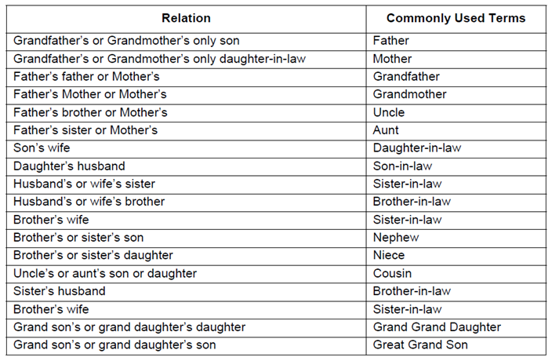

Slide 4
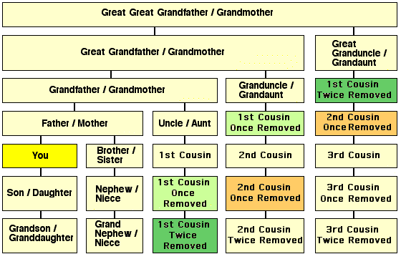
Relationship Chart:

Slide 5
Cousin or First Cousin: You are a cousin or first cousin to the child of your uncle or aunt.
Second Cousin: Your are a second cousin to the children of your parents' first cousins.
Removed: Used to describe a difference in generations.
"once removed" means that there is a difference of one generation.
First cousin Once Removed: You are a first cousin once removed to the children of your first cousins and the parents of your second cousin (your parents first cousin).
Second Cousin once Removed: The child of one's second cousin is a second cousin once removed,
sometimes called third cousin.
Cousin relationships are reciprocal. i.e. Your relation to a cousin is the same as their relation to you.

Slide 6
Great-Uncle/Aunt: A brother/sister to any of one's grandparents.
In-laws
In-laws only apply to brother, sister, and parents.
e.g. There is no relationship between you and your spouses cousins. My sister-in-law could be:
1. the sister of my spouse, or
2. the wife of my brother, or
3. the wife of my spouse's brother.

Slide 7
UNCLE: Uncle in American society this term can refer to a man in four different relative positions: father's brother; mother's brother; father's sister's husband; mother's sister's husband.
NEPHEW - NIECE: Nephew or Niece is one who is the child of a sibling (or a half-sibling, or step-sibling, or a child of a spouse's sibling, or your spouse's sibling. Since the term derives from the Latin term, "Nepos" meaning grandson, it is possible an early colonial reference may have this meaning.

Slide 8
Four thumb rule to solve Blood Relation Problems
Male is denoted by + sign and female by - sign in a family tree.
2. Father/mother and Son/daughter are joined by a vertical line to show generation gap between them.
Father/mother
Son/Daughter

Slide 9
3. Siblings(Brother sister) are joined by a horizontal line because there is no generation gap between them.
Brother Sister
Note: We never joined cousins by any line in a family tree as they are siblings from different parents.
4. Married couples are always written adjacent to each other but joined by a couple sign.
Husband Wife

Slide 10
Only use the details provided in the question to form the tree. DO NOT assume values on your own-Unless specifically provided or logically concluded.
Relations on the mother's side is called 'Maternal' while on Father's side is called 'Paternal'.

Slide 11
In every competitive exam and placement exam, Blood relation can be asked in the following three forms:
Type 1 : Indicating type or Deciphering jumbled up description
Type 2 : Relation puzzle ( A set of statements)
Type 3 : Coded blood relation ( In the form of Symbols)

Slide 12
Type 1: Indicating type Problems
1. Introducing Neeta, Anil(Male) said "She is the wife of my mother's only son'". How is Neeta related to Anil?
Wife
Sister
Mother
Aunt
Answer: A

Slide 13
Pointing to a woman in a photograph, a man said,” the son of her sister’s father is the maternal uncle of my son.” how is the sister of the woman is related to the son of the man?
Mother
Mother or mother’s sister
Mother’s sister
Aunt
Answer: B

Slide 14
Pointing a lady, a man said, “The son of her only brother is the brother of my wife”. How is the lady related to that man?
Mother’s sister
Grand mother
Sister of Father-in-law
Mother-in-law
Answer: C

Slide 15
Pointing out to a lady, Rajan said, “She is the daughter of the woman who is the mother of the husband of my mother”. Who is that lady to Rajan?
Aunt
Grand daughter
Daughter
Sister
Answer:

Slide 16
If Neha says, "Amrita's father Raj is the only son of my father-in-law Mahesh,” then how Bindu, who is the sister of Amrita related to Mahesh?
Daughter
Wife
Niece
None of these
Answer:

Slide 17
Type 2: Relation Puzzle
In these types of problems, relations will be given in the form of puzzle i.e. a set of statements. We need to draw the family tree according to given statements and answer the questions based on those relations.

Slide 18
'Ram' is the father of 'Kusha' but 'Kusha' is not his son. 'Mala' is the daughter of 'Kusha'. 'Shalaka' is the spouse of 'Ram'. 'Gopal' is the brother of 'Kusha'. 'Hari' is the son of 'Gopal'. 'Meena' is the spouse of 'Gopal'. 'Ganpat' is the father of 'Meena'. Who is the grand daughter of 'Ram'?
Mala
Meena
Hari
Shalaka
Answer:

Slide 19
X is the husband of Y. W is the daughter of X. Z is the husband of W. N is the daughter of Z. What is the relationship of N to Y.
Cousin
Niece
Daughter
Grand daughter
Answer:

Slide 20
Directions (3-5):In a family there are eight members. A is mother of B, who is brother of C. C and Q are siblings. Y is daughter of P. Z is brother in law of B, who is son of D. A has only one son. There are only two married couples in the family. P is married to B.
How is P related with Z?
Brother
Daughter
Nephew
None of these
Answer:

Slide 21
How is C related with Y?
Aunt
Daughter in Law
Uncle
Grand father
Answer:

Slide 22
How many male members are there in the family?
Four
Three
five
Two
Answer: B

Slide 23
Type 3: Coded Blood Relation
In these types of problems, relations will be given in the form of codes and symbols. We need to draw the family tree according to given symbols and answer the questions based on those relations.

Slide 24
‘ P +Q’ means that P is the son of Q, ‘P-Q’ means that P is the wife of Q, ‘P*Q’ means that P is the brother of Q, ‘P/Q’ means that P is the mother of Q and ‘P=Q’ means that P is the sister of Q. then, what does X+Y-Z mean?
Z is the father of X
Z is the son of X
Z is the uncle of X
Z is the brother of X
Answer:

Slide 25
If ‘A × D’ mean ‘D is the sister of A’, ‘A + D’ means ‘D is the daughter of A’ , ‘A ÷ D’ means ‘A is the wife of D’, and ‘A-D’ means ‘A is brother of D’ then which of the following expression shows ‘J is sister of K’ ?
J - K ÷ P + L
K + P + M × J
J – K ÷ L + P
K – J ÷ L + P
Answer:

Slide 26
Direction for Q3 & Q4: Study the following information carefully to answer these questions.
‘A$B’ means ‘A is mother of B’
‘A#B’ means ‘A is the father of B’
‘A@B’ means ‘A is the husband of B’
‘A%B’ means ‘A is daughter of B’
P@Q$M#T indicates what relationship of P with T?
Maternal Grandfather
Maternal Grandmother
Paternal Grandfather
None of the above
Answer:

Slide 27
Which of the following expressions indicates ‘R is the sister of H’?
R$D@F#H
H%D@F$R
R%D@F$H
H$D@F#R
Answer:

Slide 28
Directions (5-6):
‘A × B’ means ‘A is mother of B’.
‘A – B’ means ‘A is brother of B’.
‘A + B’ means ‘A is sister of B’.
‘A ÷ B’ means ‘A is father of B’.
If the expression M × N + R ÷ T is true, then which of the following is true?
M is father of R
N is aunt of T
M is grandfather of T
T is sister of N
Answer: B

Slide 29
Which of the following means ‘Q’ is brother of ‘T’?
Y ÷ Q – T + R
T ÷ Q – Y- R
T × M – R + Q
T + M ÷ Y + Q
Answer:

Slide 30


